Slide 1
Linking Social Technology to Employee Engagement –airBaltic Case
October 8, 2014

Slide 2
Background
Historically average employee engagement (commitment) index
Company restructuring throughout 2012 - 2014 driving it down to 48% (where only 8% remained truly engaged, « drivers»)
One of the top weaknesses mentioned by staff – insufficient information on business strategy, plans, goals and developments
None of traditional information channels seemed to achieve significant change
On a business side – decisions occasionally taken at the management level when lower level staff turned out to have different opinions (which proved to be more correct over the time)

Slide 3
Forecaster Introduction
Forecaster experiment – a social technology tool developed locally based on the principles of Prediction Markets
Prediction markets are speculative markets created for the purpose of making predictions. The current market prices can then be interpreted as predictions of the probability of the event.
More accurate than surveys and expert polling. Dynamicly reflect the most recent information
Potential for better business decisions helped to sell the idea accross top management of airBaltic

Slide 4
Key Features
Projects posted on forecaster serve following purposes:
Seek for staff feedback before making final decision
Motivate responsible project leaders to meet the deadlines
Inform staff about important events/ decisions / developments for business
Educate staff on business specifics accross functions
Project leaders suggest/post the project/statement/question + additional information if relevant
Questions/ comments/ new information regarding the project encouraged to be shared
Every participant gets equal number of virtual money (5000 BT coins) at beginning. Amount is reset at the start of each month
Employees «vote» for the positive or negative outcome of the project/ decision/ event by bying or selling shares of particular project

Slide 5
How Forecaster Helps Business?
Employees can validate the business cases before the top management makes the final decisions
Employees can use their unique insight and access to information to make faster predictions on the outcomes of projects
Everyone is better informed about airBaltic projects and targets
Which are the most important projects we are working on?
Are we on track with our key targets?

Slide 6
Forecaster Pilot - Positive Feedback
Most commonly mentioned gains
Better information flow, interesting to read the comments below each project
Feedback to project leaders on what colleagues think about a specific project
More engagement and feeling as part of decision makers
Motivating for managers to complete the project on time and according to the requirements
It is fun
Most requested features
Include projects which are still to be approved by the Board
More variety in projects from all the areas of the company
Make the page in BT corporate colors
Provide also the option to submit a poll to ask for opinions on various topics
More information about each project
Emails to managers if there are questions asked underneath their projects
Make the site dedicated to BT projects
Need more short-term projects
Need a few fun projects just to make it more interesting

Slide 7
Forecaster Pilot - Negative Feedback
There was one negative feedback regarding the overall usefulness of the project and several negatives were mentioned
It’s just a game and does not have any impact on actual performance of BT
Some colleagues are getting contacted by other colleagues who are asking questions they have “no business” knowing related to the PB projects which disrupts work
There are a few traders who may be involved in irrational or manipulative trading
Long term projects are boring
There may be some leaks of confidential information

Slide 8
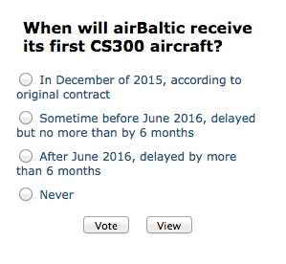
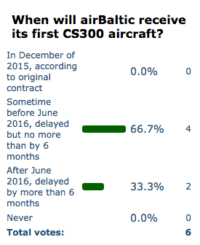
Developments During Pilot Period
The site has been moved to airBaltic exclusive domain forecaster.lv
The site has been translated to English
All the requested features have been implemented including
Various methods of sorting the projects
Notifications to project leaders about the comments
Full access to the Old Projects data base
Survey feature
Simplified Top 20
Price changes are much more gradual
Improved the admin tool to allow all the chiefs and SVPs to become administrators and be able to post new projects

Slide 9
Prize Pool – to Incentivize Using the Tool
Competition held monthly and open to all employees
Prizes minor but sufficient to maintain element of competition and fun
The total net prize pool EUR 450 per month
First place gets EUR 200
Second place gets EUR 100
Third place gets EUR 50
Special prize: EUR 100 to the author of the most insightful and helpful comment as judged subjectively by the Executive Board Members

Slide 10
Key Rules
Using insider information when making investments is allowed, however it is encouraged to share such information with others in the comment section of the project
Do not sabotage the project. Remember the goal of this is to improve information flow and decisions in the company
A lot of confidential information will be shared via this tool, so, please treat it as confidential and do not spread it outside of airBaltic
Do not cheat or manipulate the market price or try in any other way to gain unfair advantage. Remember, you are playing against your friends and colleagues so please be nice
Project leaders are allowed and encouraged to buy their projects, however they are not allowed to sell their projects. Project leaders are encouraged to post any relevant (positive or negative) news about the project in the comment section

Slide 11
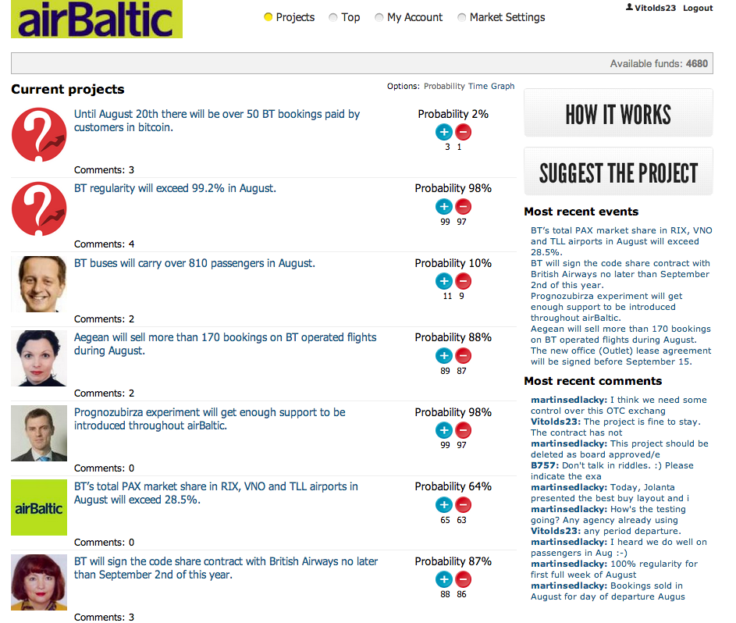
More than 20 Projects Published During the Pilot Period

Slide 12
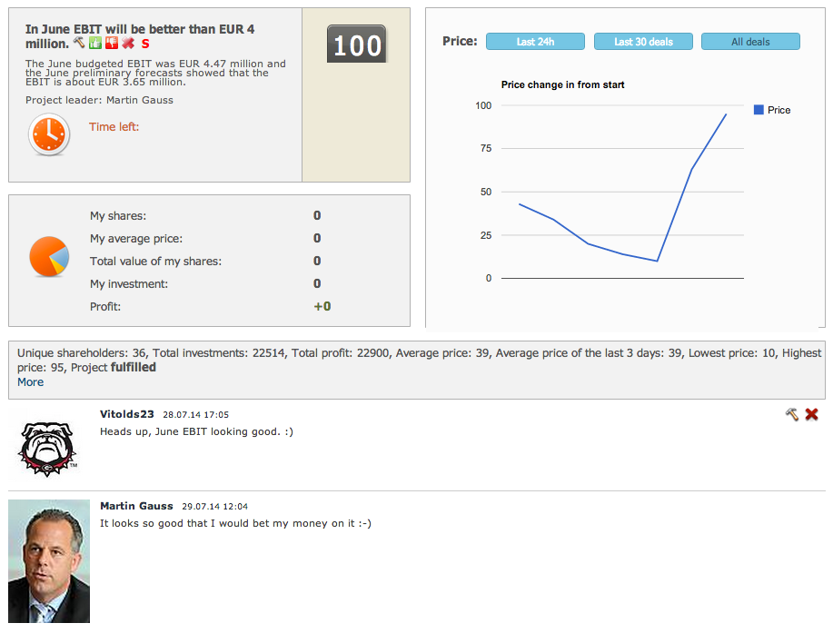
A Sample Project and Forecast

Slide 13
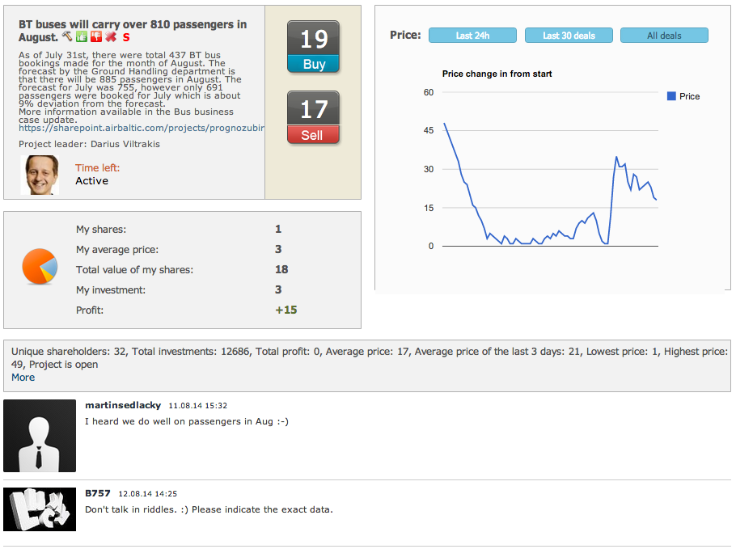
Another Sample Project

Slide 14
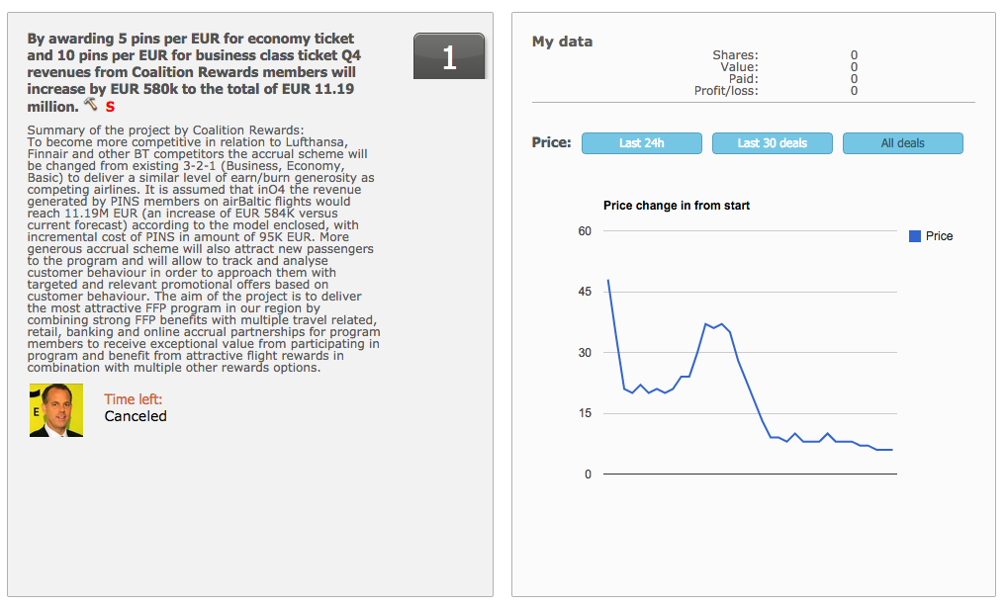
Validate Assumption for an Upcoming Business Case

Slide 15
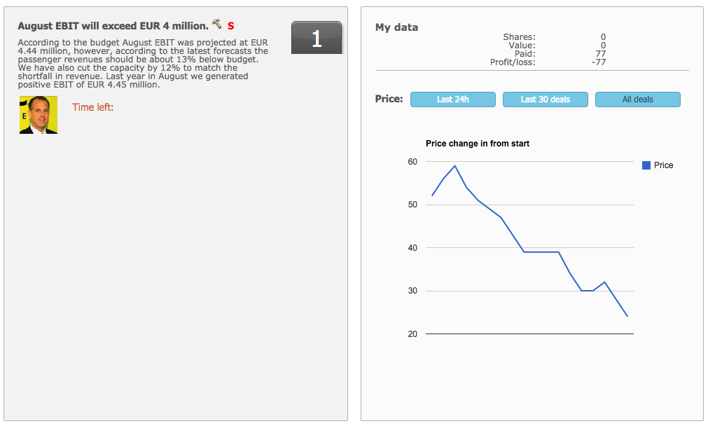
Predict a KPI Before the Final Reports Come In

Slide 16
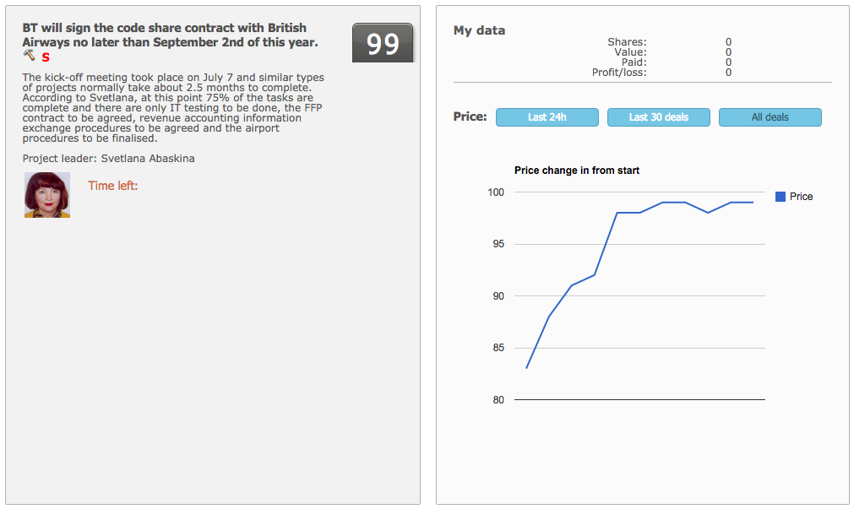
Inform Colleagues About a Key Development for airBaltic

Slide 17
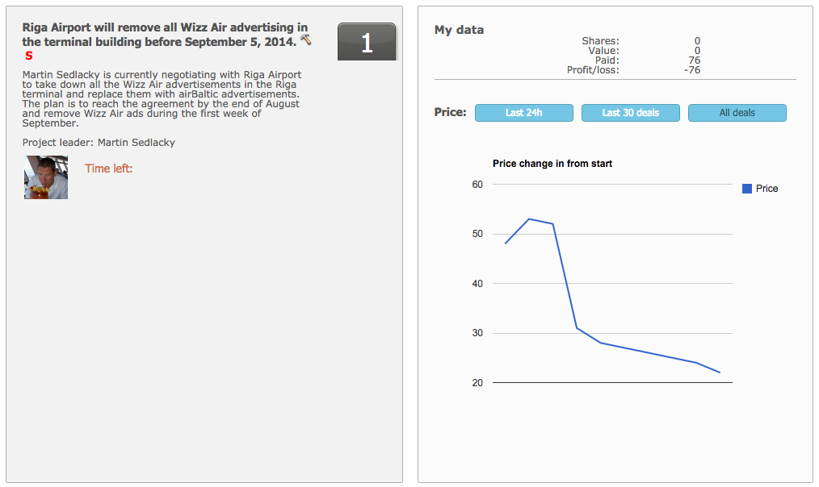
Motivate Some of the Colleagues to Achieve a Challenging Goal in Time

Slide 18
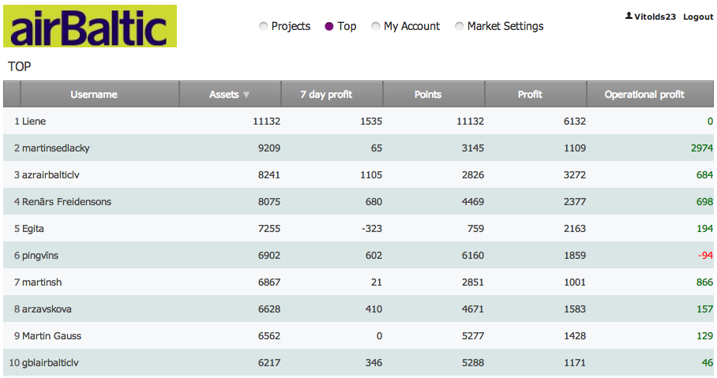
60 Colleagues Registered for Pilot, 59 Completed at Least One Transaction

Slide 19
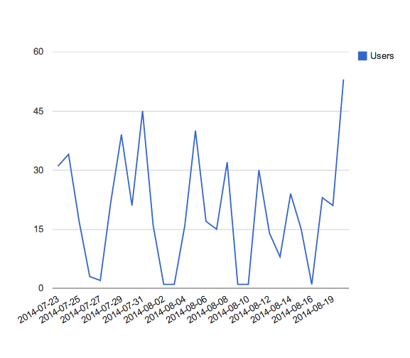
Most Days Over 20 Users (1/3) Logging In

Slide 20
Costs & Benefits
There were no direct costs related to technical support and development of the system as we serve as a test case for developer
airBaltic internal costs of running the program
Up to EUR 1,000 per month in prizes (up to EUR 12,000 per year)
Employee time spent forecasting (average time on site per user is about 5 minutes per day)
Management time needed to prepare Forecaster cases (about 30 min per case)
Management time needed to administer Forecaster (about 30 minutes per day)
Impact on EBIT – impossible to quantify, however if it helps to prevent one heavy loss making project per year then this should be highly profitable investment
Initial employee feedback after the pilot period – highly positive. Whole company access to Forecaster launched as of October 1st. During first week 230 people registered = 21% of total workforce (1100 FTE)
Impact on employee commitment index will be measured through annual survey in spring 2015. Interim survey to collect Forecaster feedback and take decision on a permanent use – in January 2015

